Slide 1
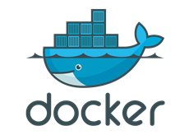
Docker Compose

Slide 2

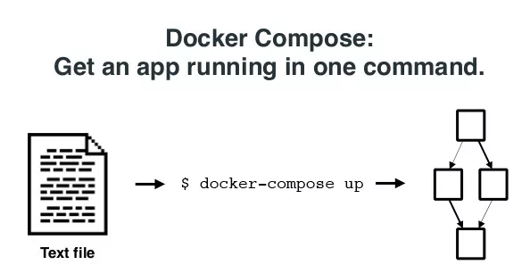
Docker Compose Overview
Container 1
Container 2
Container 3
Container 4
Compose is a tool for defining and running multi-container Docker applications.
Without a tool like Compose, creating multi-container apps can be tedious (using individual docker run commands and then linking them).

Slide 3

Docker Compose
Use a YAML file to configure your application’s services.
Specify images and configuration in a simple YAML file:
docker-compose.yml
One command to get it all running:
docker-compose up
With a single command, create and start all the services from your configuration.

Slide 4
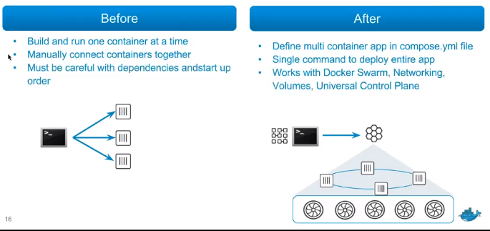
Multi Container Applications

Slide 5
Managing Services
Start/ Stop/ Rebuild services
View status/ logs of running services
$ docker ps –a
$ docker logs <container>
$ docker-compose ps
$ docker-compose logs

Slide 6
Docker Compose Use Cases
Development Environments
The Compose file provides a way to document and configure all of the application’s service dependencies (databases, queues, caches, etc). Using the Compose command line tool you can create and start one or more containers for each dependency with a single command (docker-compose up)
Automate Testing
Compose provides a convenient way to create and destroy isolated testing environments for your test suite.
$ docker-compose up -d
$ ./run_tests
$ docker-compose down

Slide 7
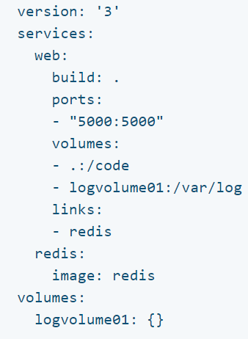
Compose is Basically a Three-Step Process
Define your app’s environment with a Dockerfile so it can be reproduced anywhere.
Define the services that make up your app in docker-compose.yml so they can be run together in an isolated environment.
Run docker-compose up and Compose starts and runs your entire app.

Slide 8
Understanding the Compose File
Version of compose file –dependent on docker version
Each piece of the application is called a service
Dockerfile should be present in the current directory
Run the redis image

Slide 9
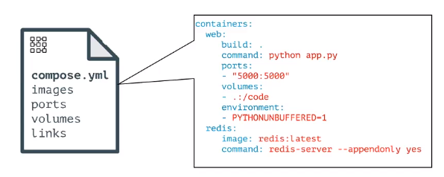
Multi Container Applications

Slide 10
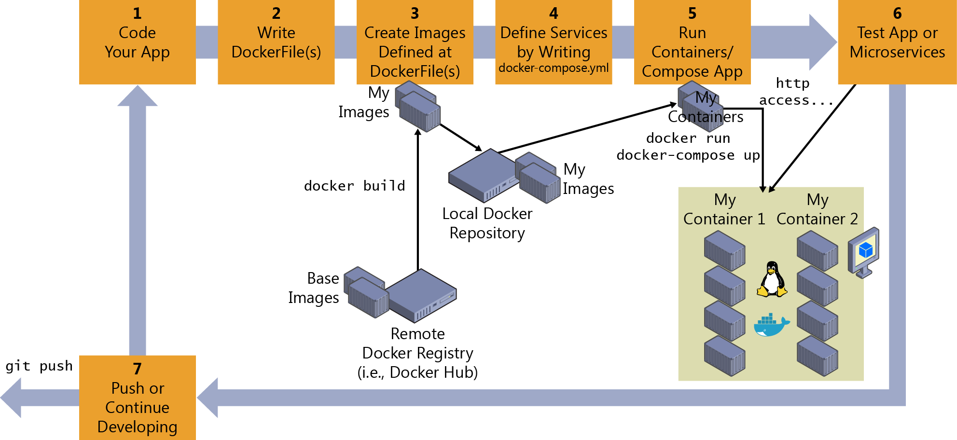
Docker Compose Lifecycle

Slide 11
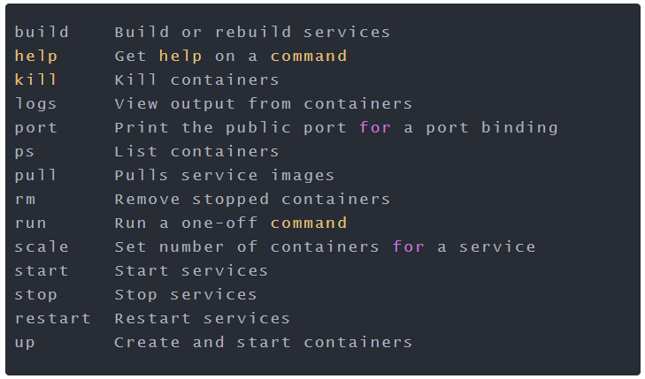
Terminology – Docker Compose
docker compose utility, which has a very similar set of commands to what is offered by docker.

Slide 12
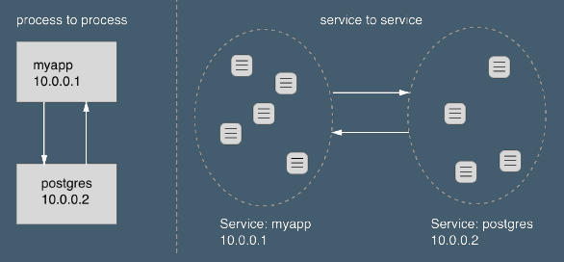
Service Discovery
Notes:
Services are assigned a Virtual IP which spreads traffic out across the underlying containers automatically.

Slide 13
Features of Docker Compose
Multiple isolated environments on a single host
Recent additions make it work with swarm mode too
Preserve volume data when containers are created
Only recreate containers that have changed
Variables and moving a composition between environments

Slide 14
Useful Commands
docker compose up
docker compose ps
docker compose logs
docker compose scale
Notes:
To use third party drivers:
https://docs.docker.com/engine/extend/plugins_network/#network-driver-plugins-and-swarm-mode

